Slide 1
NetSense & NetHealth
Social Network Data

Slide 2
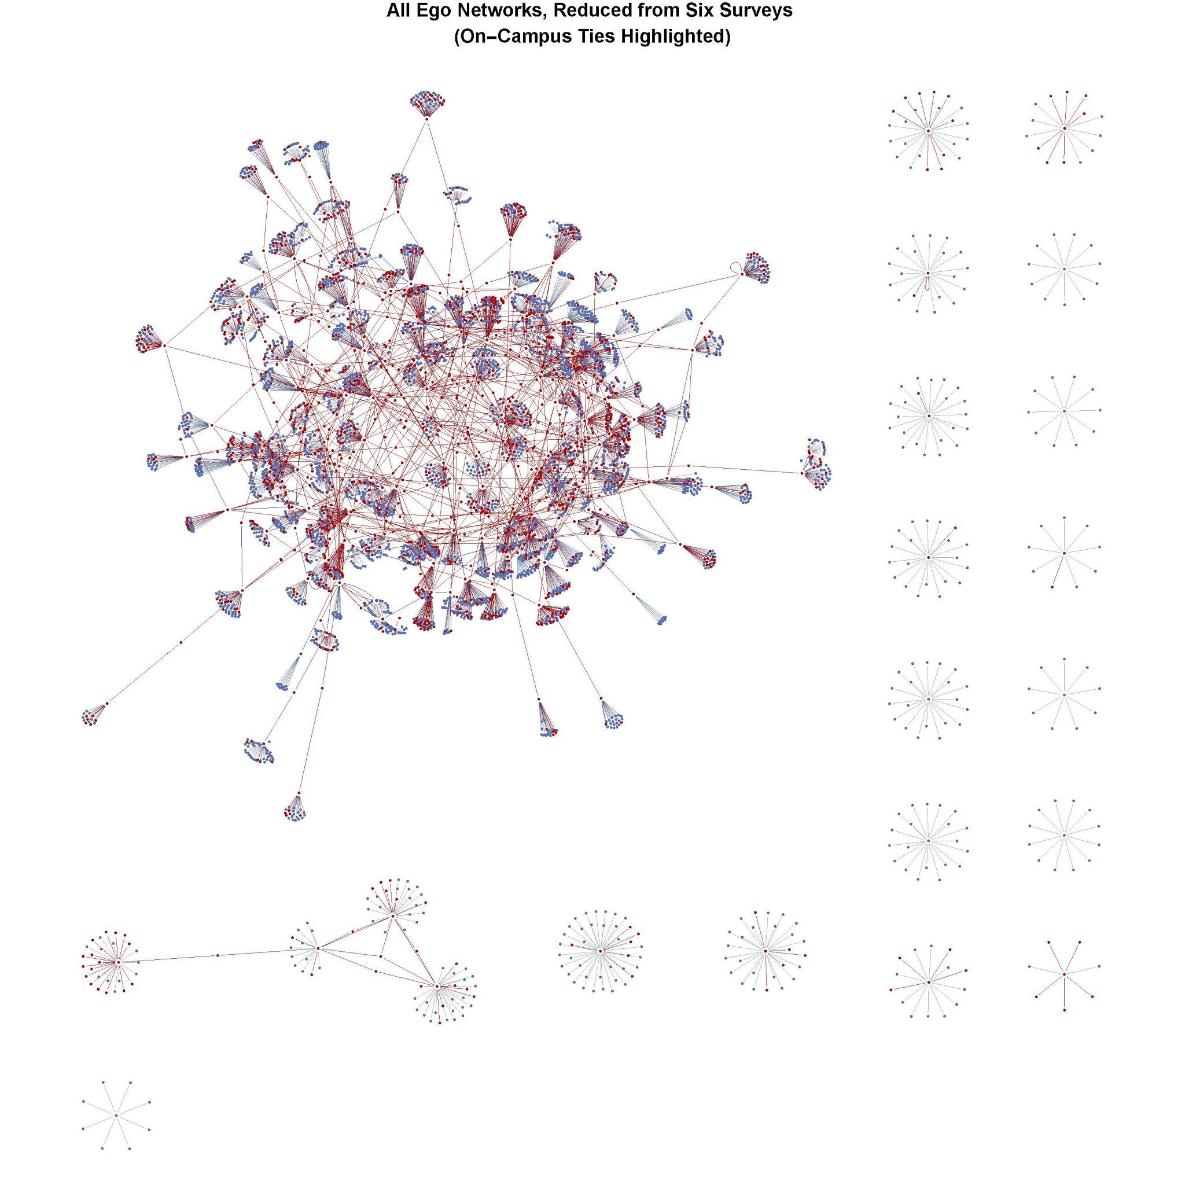
NetSense Study
2-year + data collection effort funded by NSF using CDRs obtained from smartphones
162 Notre Dame students, full data for 70 weeks
  6 million communication events
  55,000 alters
  25,000 mutual dyads, 13,000 with other ND students
  ~650 mutual dyads in which both persons are in NetSense study
No ties with other ND students prior to arrival, so students begin with no ND friends
Watch as people form ties within and between status groups
Striegel, Aaron et al. 2013. “Lessons Learned from the Netsense Smartphone Study.” Pp. 51–56 in Proceedings of the 5th ACM workshop on HotPlanet. ACM.

Slide 3
Interaction Events and Social Networks
What is a social network?
  Sets of vertices and edges: G(N,M)
  When does an edge between two vertices exist?
  Social interaction event: e_{ij}(t_{k}) = 1
    communicative interaction
Social Network Dynamics
  Temporal pattern of the interactions
  Beginning and end to a sequence of interactions

Slide 4
Dating Social Ties: Effective and Active
Begin date: time of first interaction
e_{ij}(t_{k}) = 1 | e_{ij}(t<t_{k}) = 0 for all time points t < t_{k}
End date: time of last interaction
e_{ij}(t_{k}) = 1 and e_{ij}(t>t_{k}) = 0 for all time points t > t_{k}
Left and right censoring
Active Tie:
e_{ij}(t_{k},t_{k+∆t}) = 1
Effective Tie:
x_{ij}(t_{k},t_{k+∆t}) = 1 if
    e_{ij}(t) = 1 at some point in time t prior to t_{k}
    e_{ij}(t) = 1 at some point in time t after t_{k}
Effective tie implies there could be interaction between i and j at any time between t_{k} and t_{k+∆t}

Slide 5
NetSense Data
Behavioral Event Data: Time-stamped communication event with to and from phone numbers
  Anonymized (Codebook)
Arc weekly data: 73k arcs (directed edges); within study, 1276 arcs
  Codebook
Basic (demographic) Survey
Network Survey
Courses and Grades Data
Suppl. material: coded clubs, activities, dorms; calendars

Slide 6
NetHealth Study
2-year NIH funded longitudinal study of ～700 first-year students who entered the University of Notre Dame in the Fall of 2015.
Objective: Determinants of Network clustering; selection vs. influence
  High resolution temporal data on both network and behavior.
3 Tiers of Students
  Tier 1 - 400 students recruited in Summer 2015
  Tier 2 - 100 students referred by Tier 1 students, Fall 2015
  Tier 3 - 300 students recruited Winter 2015 (second semester)

Slide 7
NetHealth Data
Event data
Arc data (100 weeks) (16k+): within study only (NetHealthWeeklyArcs_100th.dta)
  Node level data (kapp_daily_longDH.dta)
Basic Survey Data (Basic_Survey_Merged_W1-5(6-29-17).dta)
Network Survey Data
Fitbit Data (8/15-8/17)
  Activity (dailyfitbit.dta)
  Sleep (dailysleep.dta)

